Slide 1
Click Through Rate Prediction
Topics:
Data Analysis
SMOTE and RFECV
XGBOOST ML Technique
Evaluation Metric
Limitations of XGBOOST

Slide 2
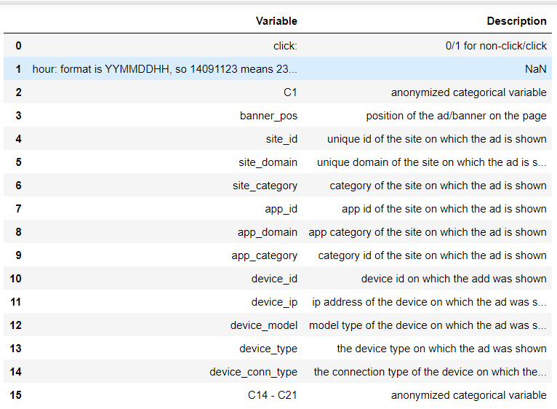
Data Analysis
Introduction: An important exercise marketing companies need to do before making any of the decisions related to advertisements is a click-through rate (CTR) prediction. The objective is to predict whether the audience will click on an ad or not and thus help the marketing team answer ad placement-related questions.
As we see lot of data is captured to analyze, what can make an individual to click on advertisement.
An initial Exploratory Data Analysis was done using,
One hot encoding on categorical data
Missing Data analysis
Selection of columns based on business need and cost. Most importantly computational cost .
Calculated CTR for different categorical Features.

Slide 3
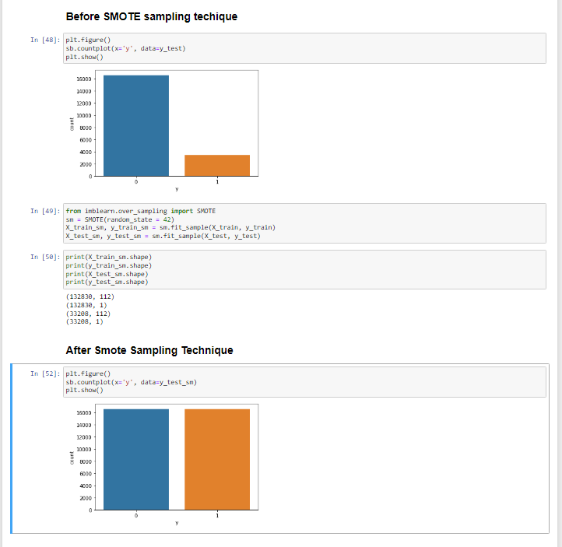
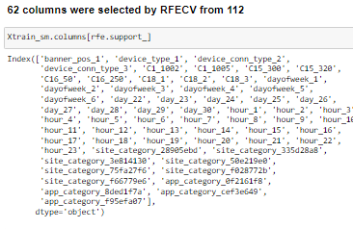
2.SMOTE and RFECV
Why SMOTE?
our minority class have less data captured. This creates a lot of imbalance in our dataset for prediction, one way to mitigate this issue is by adding Synthetic Data which can be achieved by SMOTE
SMOTE is an oversampling technique where the synthetic samples are generated for the minority class. This algorithm helps to overcome the overfitting problem posed by random oversampling.
Why RFECV?
sklearn.feature_selection.RFE simply trains an estimator that assigns weights to features. It takes out the feature importance based on that estimator and recursively prunes it. Recursive feature elimination with cross-validation on the other hand, add Cross-validation into the mix.
Also, this approach is good for highly imbalance datasets because it uses stratified CV (cross Validation) by default, from sklearn’s.

Slide 4
3. XGBOOST ML Technique
Why XGBOOST ?
XGBOOST can handle noisy data gracefully during analysis. since we made use of SMOTE to overcome imbalance dataset issue on minority class, though SMOTE is good on restricting overfitting but it adds some noise, hence XGBOOST is good to handle this situation.
When we did Recursive Feature Elimination, Cross-Validated (RFECV) & some stats techniques (P-val & VIF) to drill down to 56 columns from 63 that we got after Recursive Feature Elimination, Cross-Validated (RFECV). We can still drilldown to much lower number of feature by looking at co-relationship table and VIF(based on business need). In this situation when we are not completely accurate on number of features which we may add or subtract by using other feature selection techniques, XGBOOST works well, since apart from handling noisy data , handling change in features is also one of the advantages of XGBOOST. This is the exact reason we saw that our accuracies did not fell after we applied Feature Elimination, Cross-Validated (RFECV) selected features.

Slide 5
4. Evaluation Metric
What are the metrics determining XGBOOST to be good?
we see that Recall & Precision values are highest for XGBOOST.
A good Recall value is very important because, Recall value is calculated as the ratio between the numbers of Positive samples correctly classified as Positive to the total number of Positive samples. The recall measures the model's ability to detect positive samples. The higher the recall, the more positive samples detected.
A good Precision tells how good the model is at predicting a specific category.

Slide 6
5. Limitations of XGBOOST
XGBoost does not perform so well on sparse and unstructured data.
A common thing often forgotten is that Gradient Boosting is very sensitive to outliers since every classifier is forced to fix the errors in the predecessor learners.
The overall method is hardly scalable. This is because the estimators base their correctness on previous predictors, hence the procedure involves a lot of struggle to streamline.

Slide 7
Thank You
--- Mohammed Azhar Khan

